Slide 1
Analysing different statistical representations
Numerical summaries of data

Slide 2
how to use Oak lessons

Slide 3
I can use the different statistical representations to compare two sets of data.

Slide 4
A statistical summary sums up the features of a data set.
It may contain the average (mean, median and/or mode) which measure the central tendency. It may also contain the range which measures the spread.
Each measure used in a statistical summary is called a summary statistic.
A measure of central tendency is a summary measure that attempts to describe a whole set of data with a single value that represents the middle or centre of its distribution.
The spread/dispersion of data values describes how far apart the pieces of data are.

Slide 5

Analysing different statistical representations
Comparing summary statistics to statistical graphs
Completing graphs from summary statistics
Sketching graphs from summary statistics

Slide 6
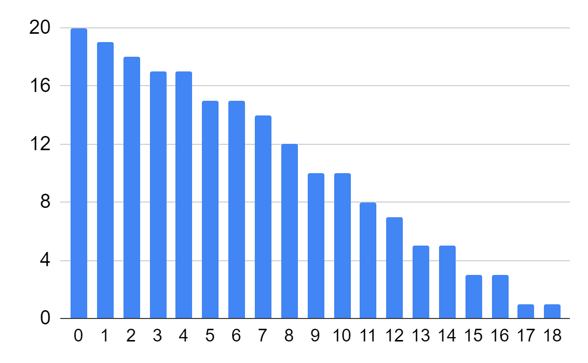
Comparing summary statistics to statistical graphs
Trying to understand and compare large datasets of raw data is often impractical.
0 | 0 | 0 | 0 | 0 | 0 | 0 | 0 | 0 | 0 | 0 | 0 | 0 | 0 | 0 | 0 | 0 | 0 | 0 | 0 | 1 | 1 | 1 | 1 | 1
1 | 1 | 1 | 1 | 1 | 1 | 1 | 1 | 1 | 1 | 1 | 1 | 1 | 1 | 2 | 2 | 2 | 2 | 2 | 2 | 2 | 2 | 2 | 2 | 2
2 | 2 | 2 | 2 | 2 | 2 | 2 | 3 | 3 | 3 | 3 | 3 | 3 | 3 | 3 | 3 | 3 | 3 | 3 | 3 | 3 | 3 | 3 | 3 | 4
4 | 4 | 4 | 4 | 4 | 4 | 4 | 4 | 4 | 4 | 4 | 4 | 4 | 4 | 4 | 4 | 5 | 5 | 5 | 5 | 5 | 5 | 5 | 5 | 5
5 | 5 | 5 | 5 | 5 | 5 | 6 | 6 | 6 | 6 | 6 | 6 | 6 | 6 | 6 | 6 | 6 | 6 | 6 | 6 | 6 | 7 | 7 | 7 | 7
7 | 7 | 7 | 7 | 7 | 7 | 7 | 7 | 7 | 7 | 8 | 8 | 8 | 8 | 8 | 8 | 8 | 8 | 8 | 8 | 8 | 8 | 9 | 9 | 9
9 | 9 | 9 | 9 | 9 | 9 | 9 | 10 | 10 | 10 | 10 | 10 | 10 | 10 | 10 | 10 | 10 | 11 | 11 | 11 | 11 | 11 | 11 | 11 | 11
12 | 12 | 12 | 12 | 12 | 12 | 12 | 13 | 13 | 13 | 13 | 13 | 14 | 14 | 14 | 14 | 14 | 15 | 15 | 15 | 16 | 16 | 16 | 17 | 18
So we process the data to help us to interpret and explain what is going on.
mean | 5.79
median | 5
mode | 0
range | 18
summary statistics
statistical graphs

Slide 7
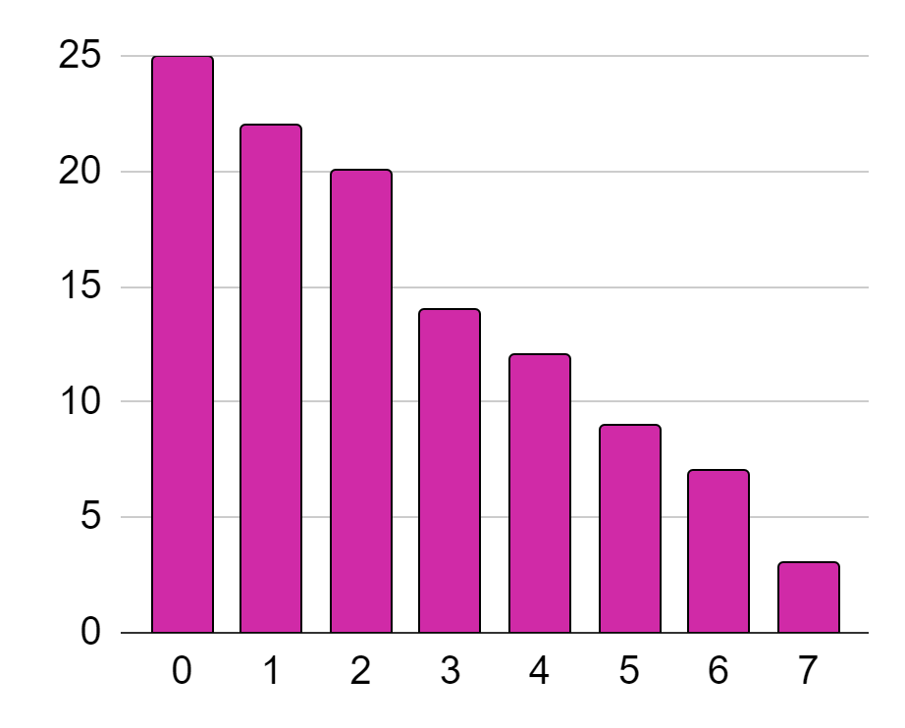
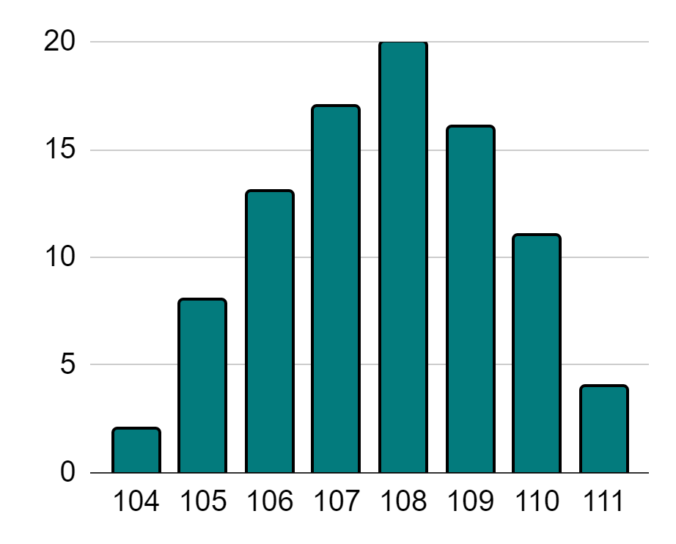
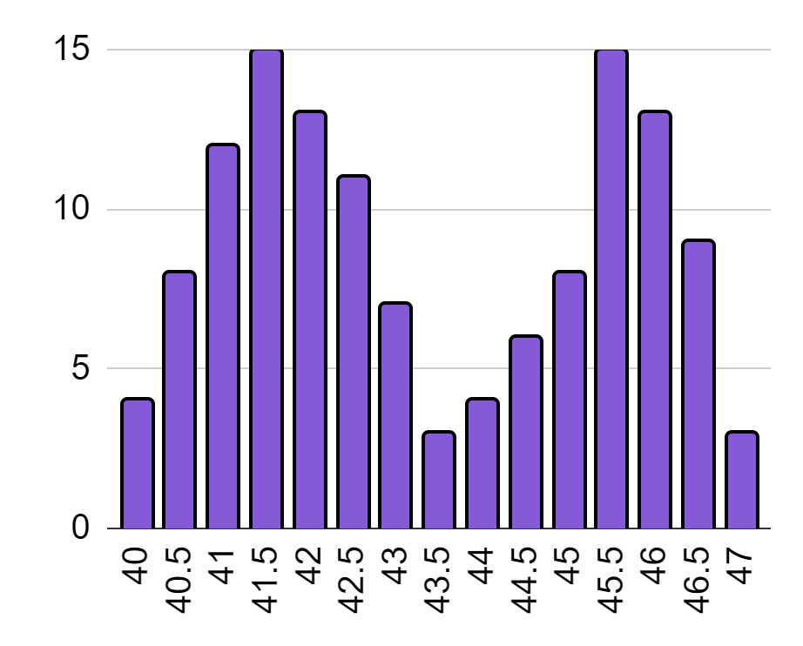
Comparing summary statistics to statistical graphs
Using one summary statistic on its own gives very little insight into how a dataset is distributed.
range | 7
Each of these datasets has a range of 7, and yet their distributions all look very different!
For example, all the range tells us is how varied the data are.

Slide 8
Comparing summary statistics to statistical graphs
Using more summary statistics to represent a dataset will refine what the corresponding graph will look like.
range | 7
mode | bimodal at 41.5 and 45.5
This is the only bar chart that represents a bimodal dataset.
Which of these graphs satisfies both of these summary statistics?

Slide 9
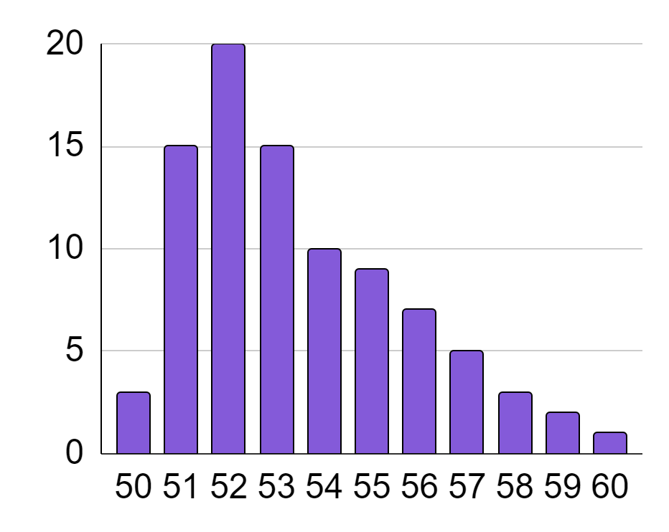
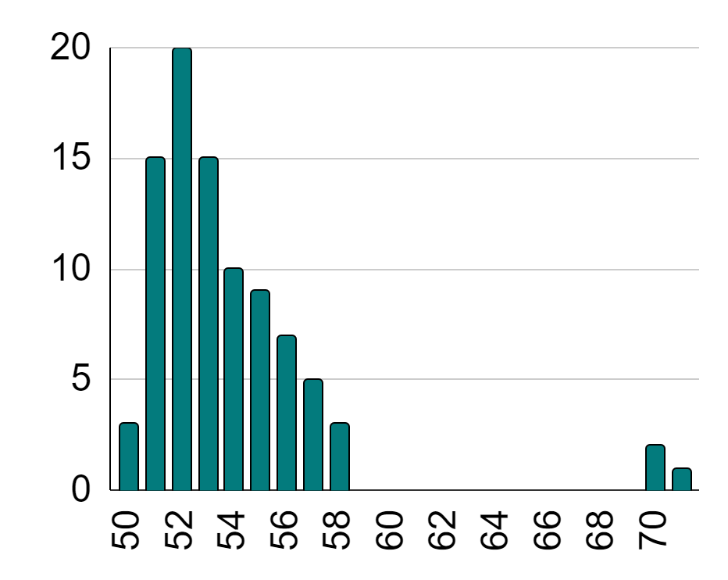
Comparing summary statistics to statistical graphs
Graphs may be affected by outliers or extreme data points.
mean
tail
tail is longer
mean moves further from the peak
With distributions like this, the mean tends to be close to the peak, in the direction of the longer tail.
However, if a distribution has outliers or longer tails, the mean gets pulled further away from the peak in the direction of the tail.

Slide 10
Comparing summary statistics to statistical graphs
The median is the middle value.
median of 53
The total heights of all the bars to the left of the median value…
total height of around 38
Should be approximately equal to the total heights of all the bars to the right of the median value, even if both sides are distributed very differently.
total height of around 37

Slide 11

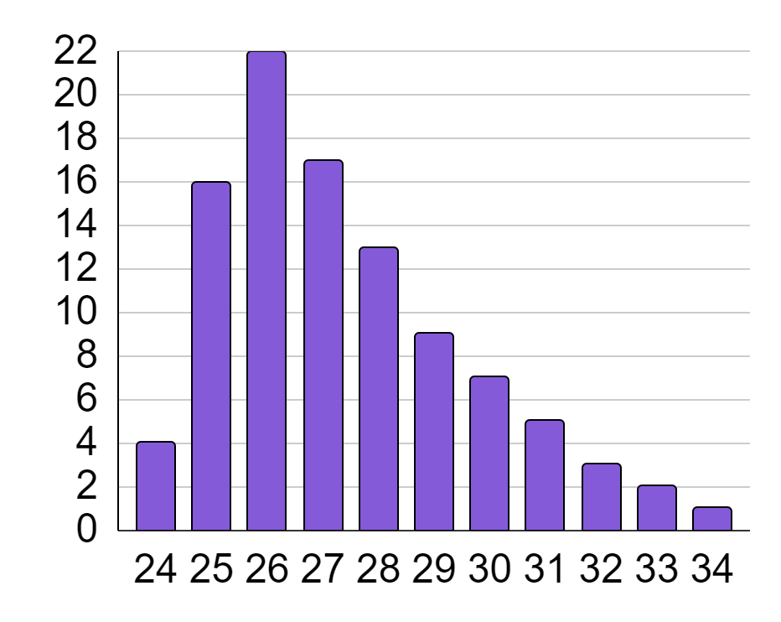
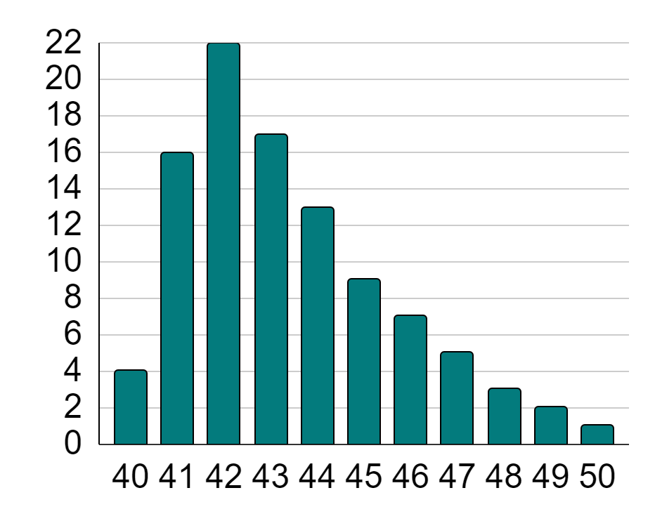
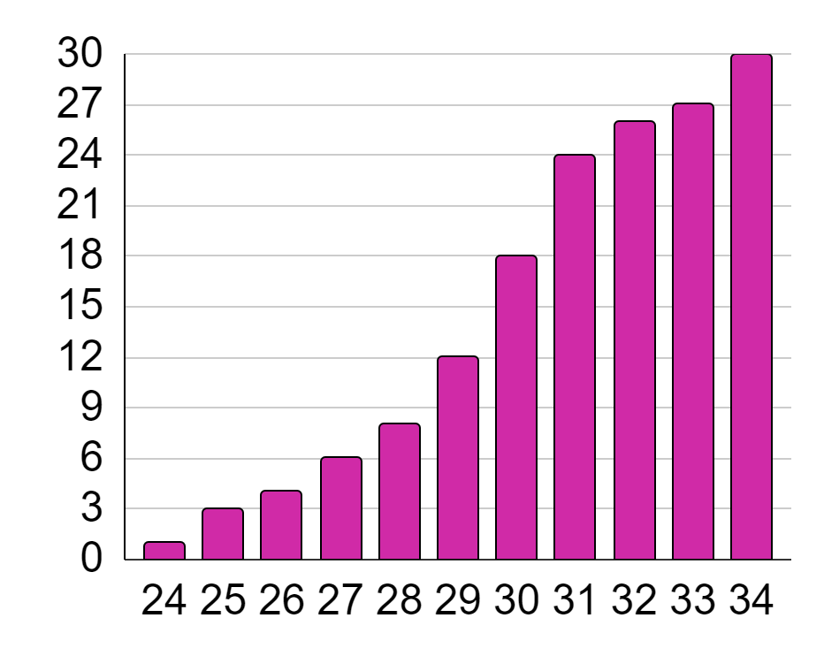
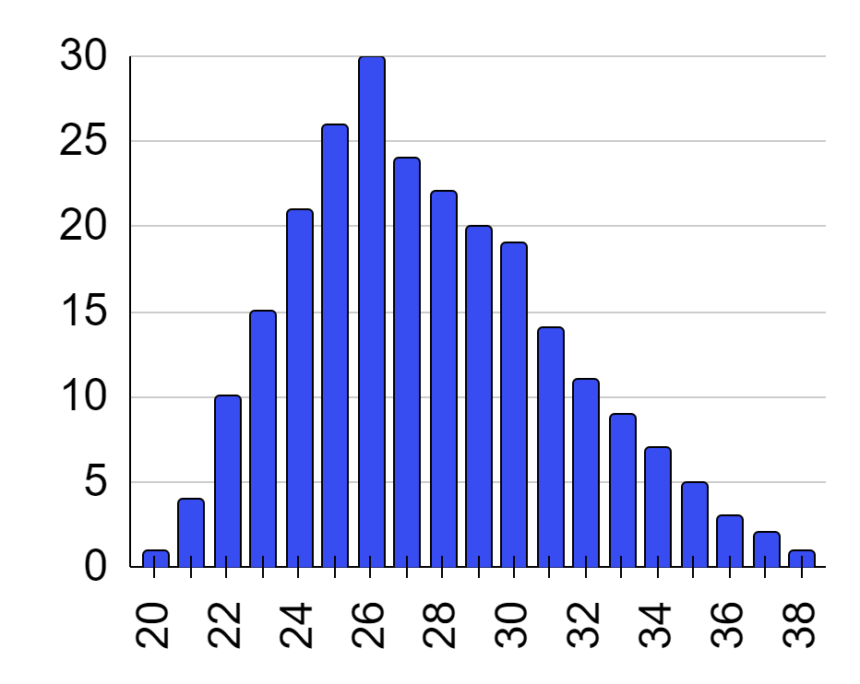
Comparing summary statistics to statistical graphs
To figure out which graph represents a dataset described by summary statistics, it is best to first rule out graphs that it cannot be.
A summary statistic will be revealed one at a time. After each statistic is revealed, rule out the graphs it cannot be until only the correct graph remains.
a
b
c
d

Slide 12
Comparing summary statistics to statistical graphs
a
b
mean | 27.4
For graphs that don’t have outliers, the mean is more likely to be in the area around the peak.
c
d

Slide 13

Comparing summary statistics to statistical graphs
a
b
mean | 27.4
b cannot have a mean of 27.4, as b only has data between 40 and 50.
c
d

Slide 14
Comparing summary statistics to statistical graphs
a
b
mean | 27.4
The mean will rarely deviate too far from the peak.
c
d
On graph c, 27.4 is too far towards the tail of the graph.

Slide 15
Comparing summary statistics to statistical graphs
a
b
mean | 27.4
mode | 26
The mode is the most frequent data point.
Graphically, this is represented by the tallest bar on the bar chart.
c
d
Both a and d have 26 as the mode.

Slide 16

Comparing summary statistics to statistical graphs
a
b
mean | 27.4
mode | 26
range | 10
The range is the difference between the largest data point and the smallest data point.
a: 34 - 24 = 10
d: 38 - 20 = 18
c
d

Slide 17
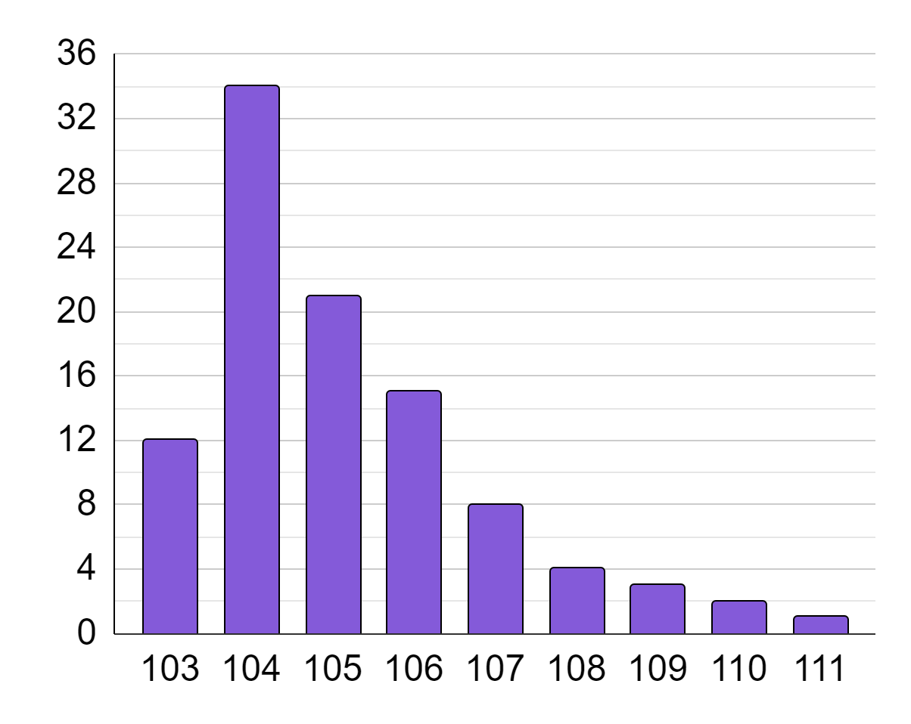
Comparing summary statistics to statistical graphs
Which of these summary statistics does not represent the data shown on the bar chart?
mean | 105
median | 111
mode | 104
range | 8
The median is the central value when ordered. By quick inspection it is possible to see that 111 is the maximum/highest value (and has a low frequency).

Slide 18
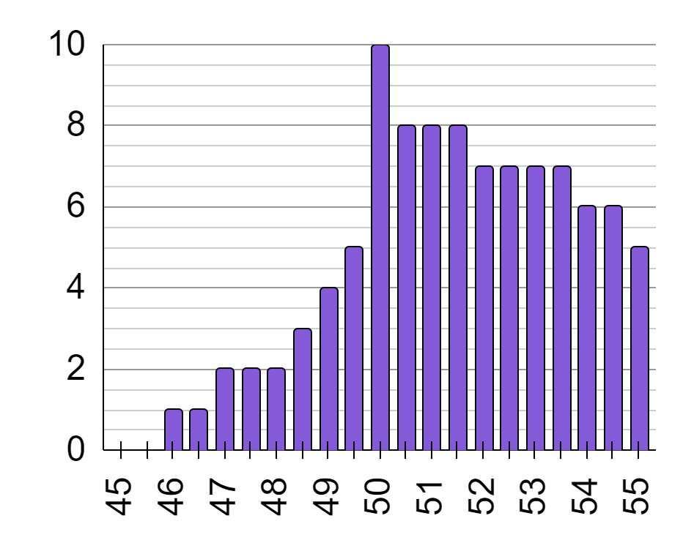
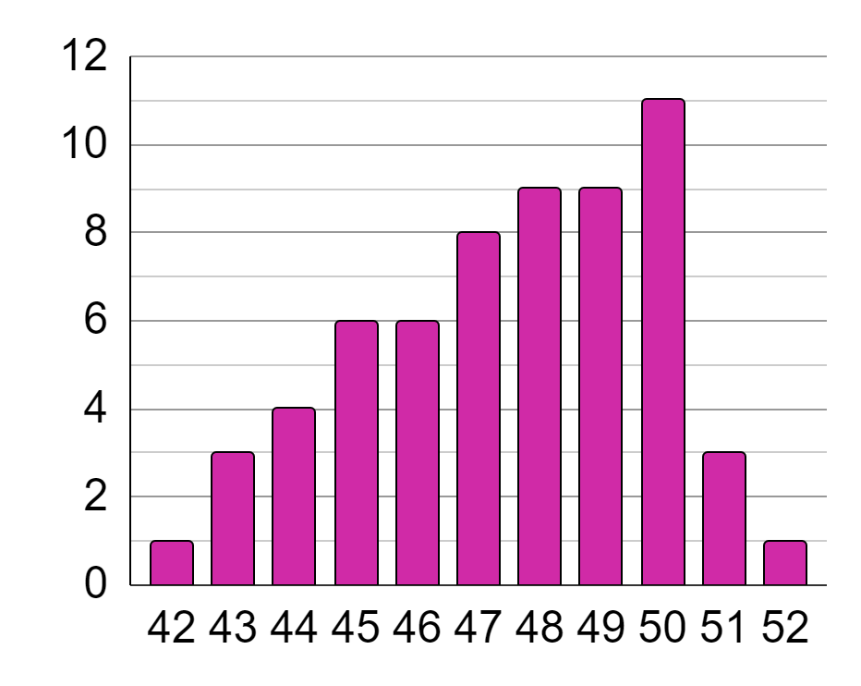
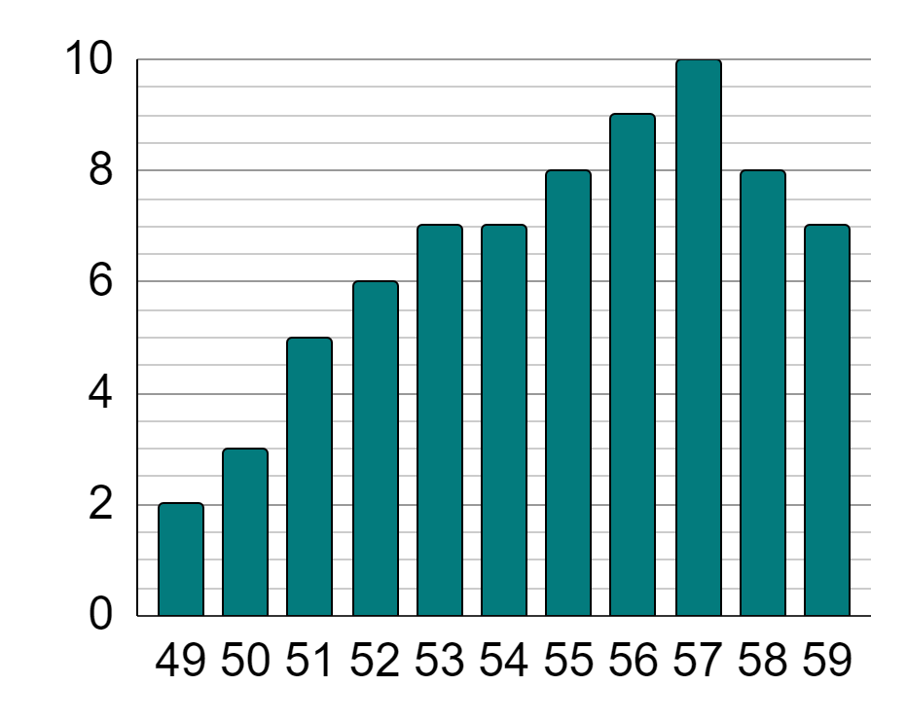
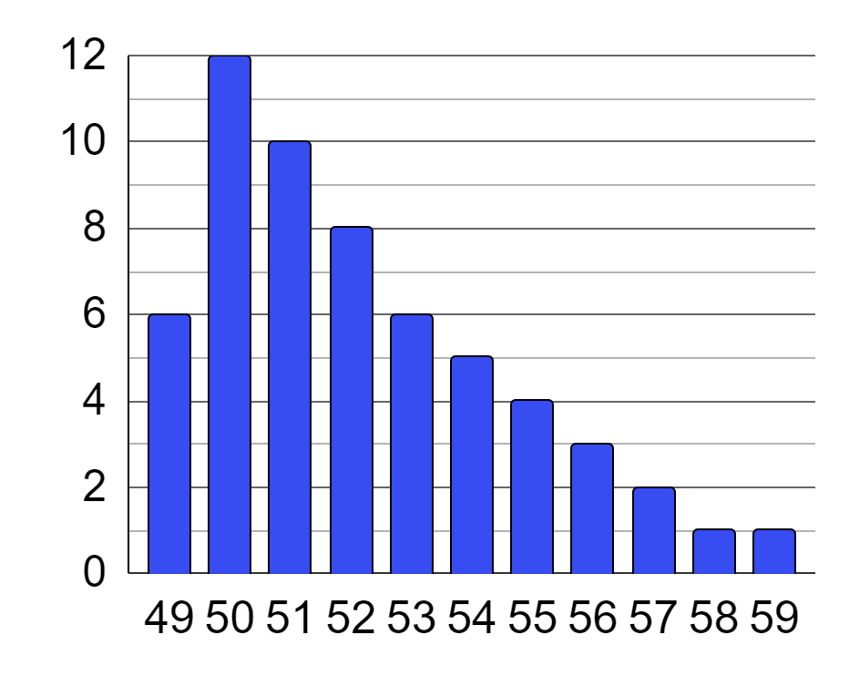
Comparing summary statistics to statistical graphs
1) Which of these summary statistic values is applicable to bar charts a, b, c, d, or any combination of them?
a
b
 |  | a | b | c | d
mean | 55
median | 48
mode | 50
range | 10
c
d

Slide 19
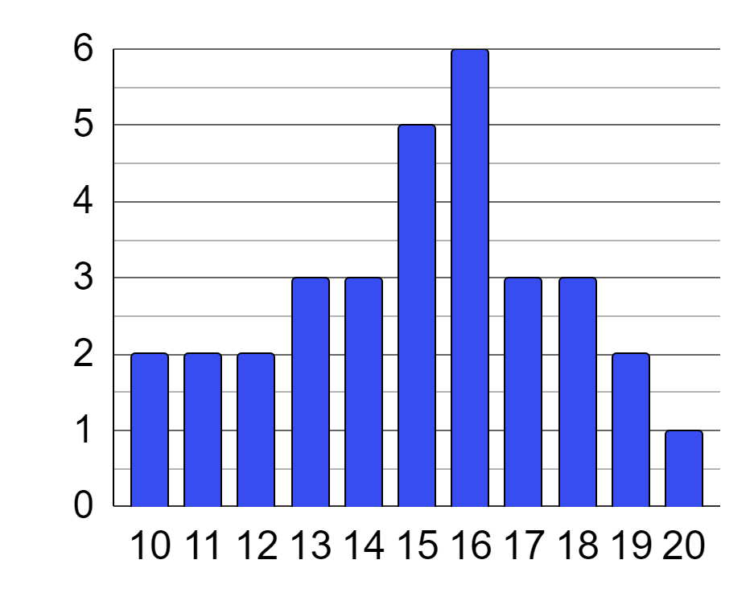
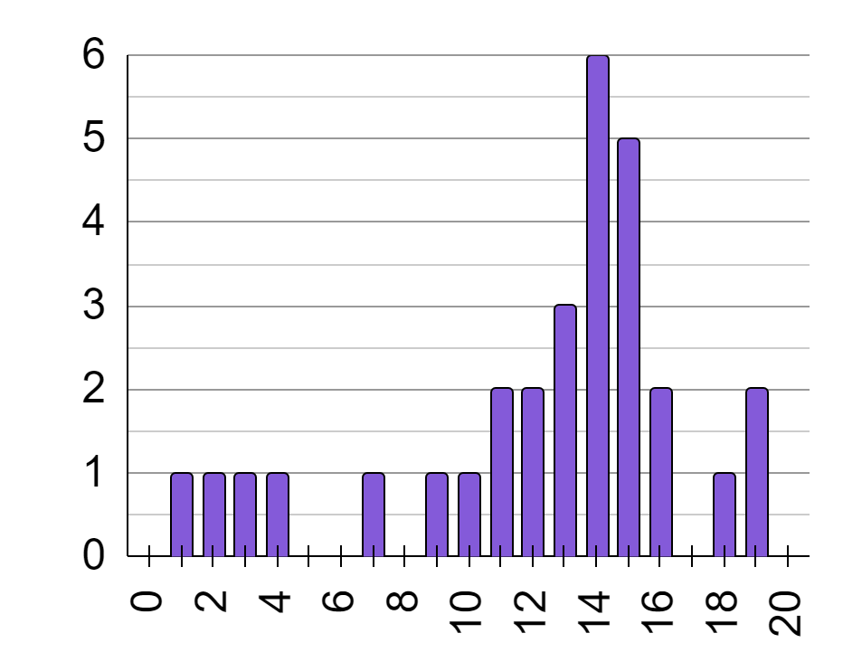
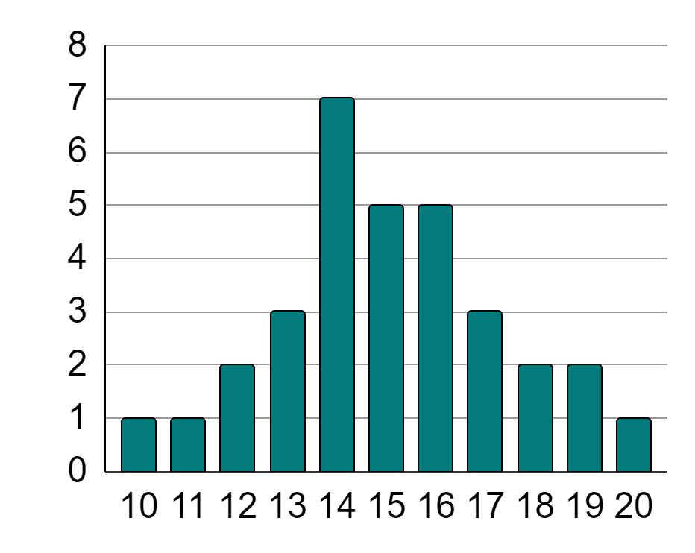
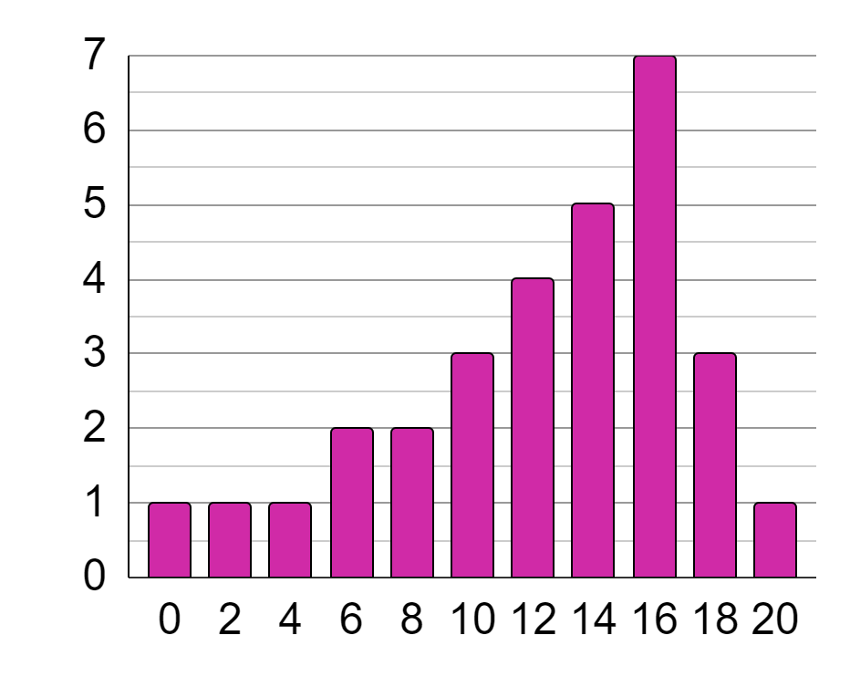
Comparing summary statistics to statistical graphs
2) Each summary statistic below matches with a pair of bar charts. For each summary statistic, write down its value and the names of the two classes it represents.
score of class a
score of class b
score of class c
score of class d
mean | 15 | a
mean | 12.3 | b
mode | 16
mode |  | c
range

Slide 20
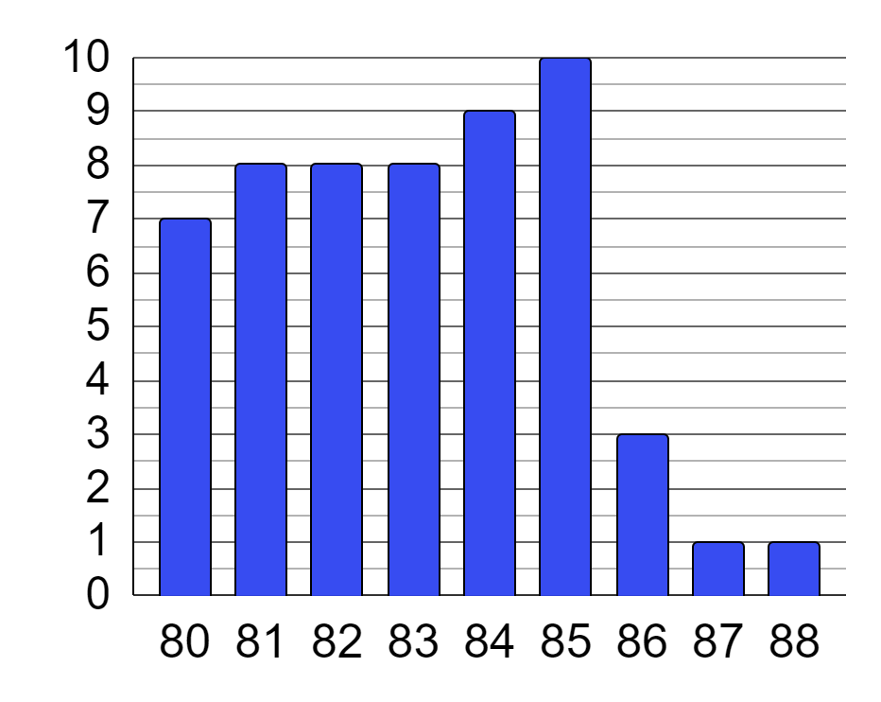
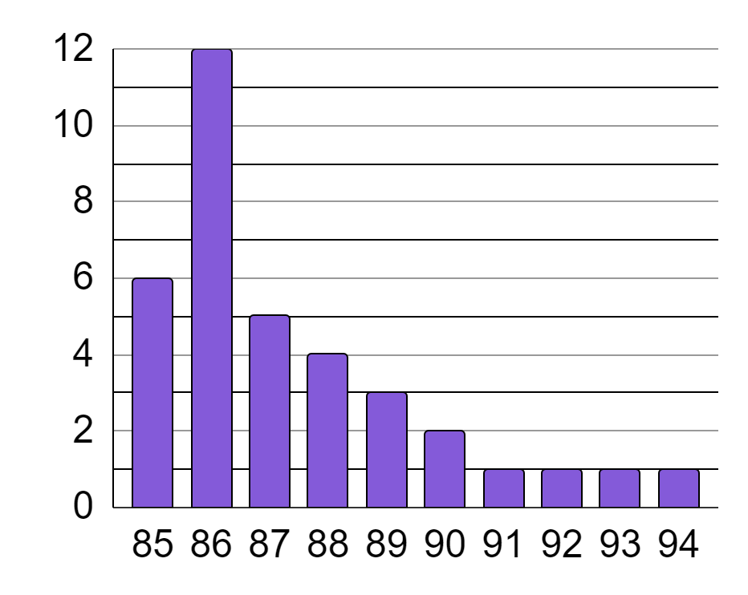
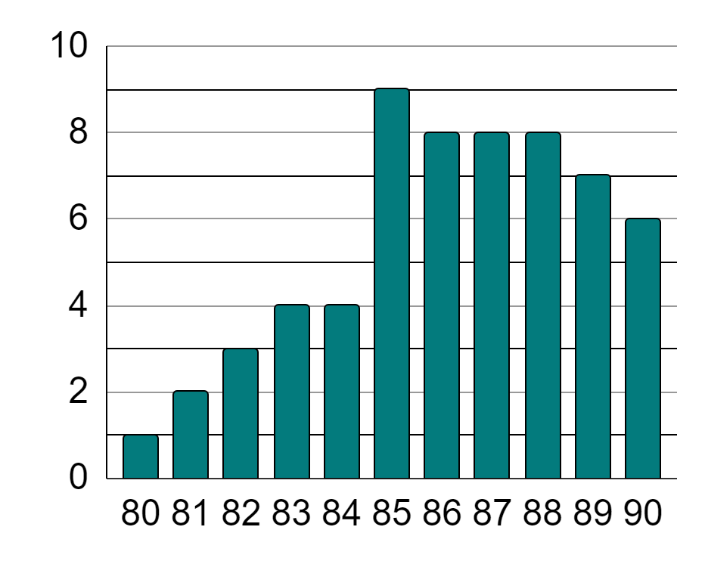
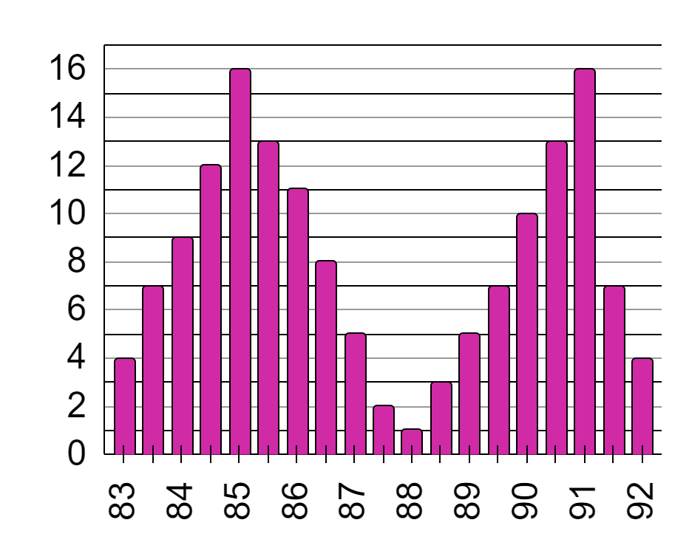
Comparing summary statistics to statistical graphs
a
b
3) Place a ✓ by each letter if all summary statistics given accurately represent the corresponding bar chart.
mean | 87.4
a | b | c | d
mean | 87.4
c
d
range | 9
mode | 85
mean | 87.4
a | b | c | d
range | 9
a | b | c | d

Slide 21
Comparing summary statistics to statistical graphs
1) Which of these summary statistic values is applicable to bar charts a, b, c, d, or any combination of them?
a
b
 |  | a | b | c | d
mean | 55
median | 48
mode | 50
range | 10
c
d

Slide 22
Comparing summary statistics to statistical graphs
2) Each summary statistic below matches with a pair of bar charts. For each summary statistic, write down its value and the names of the two classes it represents.
score of class a
score of class b
score of class c
score of class d
mean | 15 | a | c
mean | 12.3 | b | d
mode | 16 | a | d
mode | 14 | c | b
range | 10 | a | c

Slide 23
Comparing summary statistics to statistical graphs
a
b
3) Place a ✓ by each letter if all summary statistics given accurately represent the corresponding bar chart.
mean | 87.4
a | b | c | d
mean | 87.4
c
d
range | 9
mode | 85
mean | 87.4
a | b | c | d
range | 9
a | b | c | d

Slide 24
Analysing different statistical representations
Comparing summary statistics to statistical graphs
Completing graphs from summary statistics
Sketching graphs from summary statistics

Slide 25

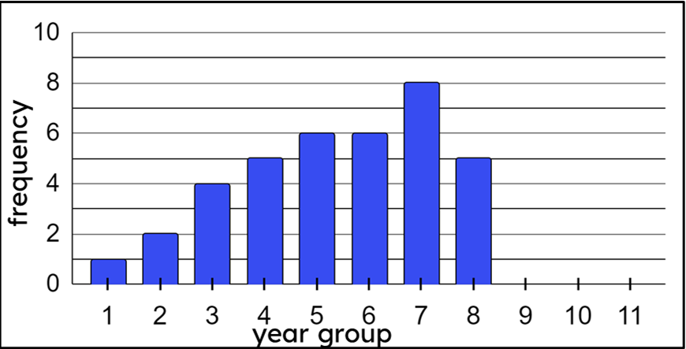
Completing graphs from summary statistics
Laura collects data on 40 students using the library after school and begins to plot a bar chart.
She knows the dataset has a range of 9, but she loses the raw data before she can complete the bar chart.
What information can she use to help her complete the bar chart?
Can she accurately complete the bar chart with the information she has?

Slide 26
Completing graphs from summary statistics
Laura collects data on 40 students using the library after school and begins to plot a bar chart.
She knows the dataset has a range of 9, but she loses the raw data before she can complete the bar chart.
There are 40 students in total. How many students are not already represented by the bar chart?
8
6
6
5
5
4
1 + 2 + 4 + 5 + 6 + 6 + 8 + 5 =
2
1
37
40 - 37 = 3 students not shown on the bar chart.

Slide 27
Completing graphs from summary statistics
Laura collects data on 40 students using the library after school and begins to plot a bar chart.
She knows the dataset has a range of 9, but she loses the raw data before she can complete the bar chart.
Because the bar chart has a range of 9, the highest year group must be year 10.
This means that no year 11s were in the library after school that day.
10 - 1 = range of 9

Slide 28
Completing graphs from summary statistics
Laura collects data on 40 students using the library after school and begins to plot a bar chart.
She knows the dataset has a range of 9, but she loses the raw data before she can complete the bar chart.
10 - 1 = range of 9
Which means, as long as year 10 gets at least one of the three remaining students, the other two students can be distributed between years 9 and 10 in any way.

Slide 29
Completing graphs from summary statistics
Laura collects data on 40 students using the library after school and begins to plot a bar chart.
She knows the dataset has a range of 9, but she loses the raw data before she can complete the bar chart.
All three could go into year 10.
10 - 1 = range of 9
Or two could go in year 10, and one in year 9.
Or one could go in year 10, and the other two in year 9.
There isn’t a single solution so she needs more information

Slide 30

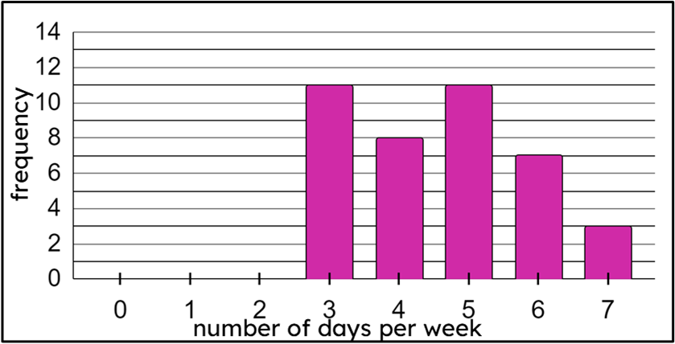
Completing graphs from summary statistics
1) Alex goes to his local town centre and collects data on the number of days per week people visit the town centre.
He loses some of the data he collected, but knows that he asked 58 people, the range is 6 days, and the modal number of days is 2.
a) Which bar does Alex know he must leave blank?
b) How many people are not yet represented on the bar chart?
c) Complete a bar chart that shows this.

Slide 31

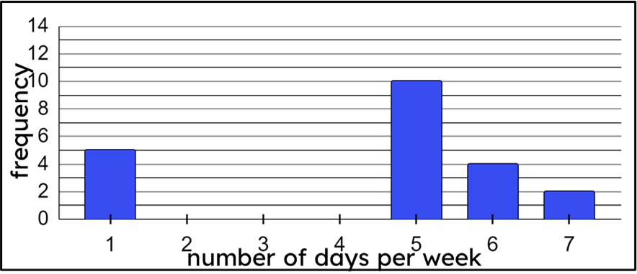
Completing graphs from summary statistics
2) Jun goes to his local town centre and collects data on the number of days per week people visit the town centre.
He loses some of the data he collected, but knows that he asked 46 people, the data are bimodal, and that more people visit 7 times a week than 2 times a week.
a) How many people are not yet represented on the bar chart?
b) How many people go to town 2 times per week?
c) Complete the bar chart.

Slide 32
Completing graphs from summary statistics
1) Alex goes to his local town centre and collects data on the number of days per week people visit the town centre.
He loses some of the data he collected, but knows that he asked 58 people, the range is 6 days, and the modal number of days is 2.
at least 12
a) Which bar does Alex know he must leave blank?
0 days
at most 6
b) How many people are not yet represented on the bar chart?
18 people
c) Complete a bar chart that shows this.

Slide 33
Completing graphs from summary statistics
2) Jun goes to his local town centre and collects data on the number of days per week people visit the town centre.
He loses some of the data he collected, but knows that he asked 46 people, the data are bimodal, and that more people visit 7 times a week than 2 times a week.
a) How many people are not yet represented on the bar chart?
12
12
25 people
b) How many people go to town 2 times per week?
1
1 person
c) Complete the bar chart.

Slide 34
Analysing different statistical representations
Comparing summary statistics to statistical graphs
Completing graphs from summary statistics
Sketching graphs from summary statistics

Slide 35
Sketching graphs from summary statistics
Sketching a graph is a quick way of visualising the shape or distribution of a graph without spending too much time drawing it completely accurately.
This may be because:
you do not know all the values and frequencies.
you’re not sure of the scale of the axes.
you only know some of the summary statistics of the dataset.
it is for use in planning only, before representing full results on an accurate graph.
Sketches do not need to look perfect, but they should still follow the rules of what a graph (such as a bar chart) should and shouldn’t look like.

Slide 36

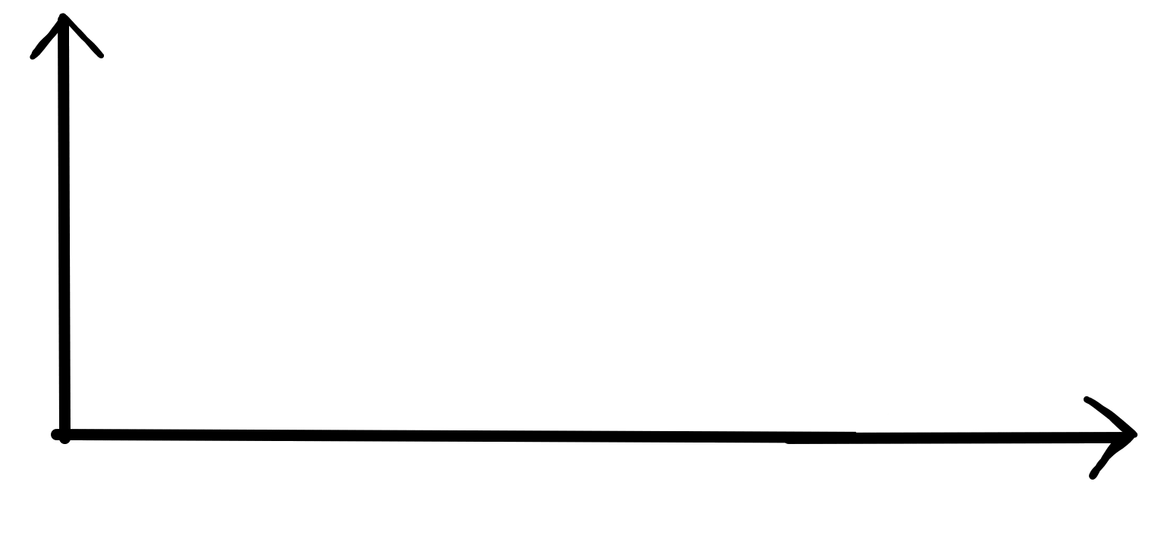
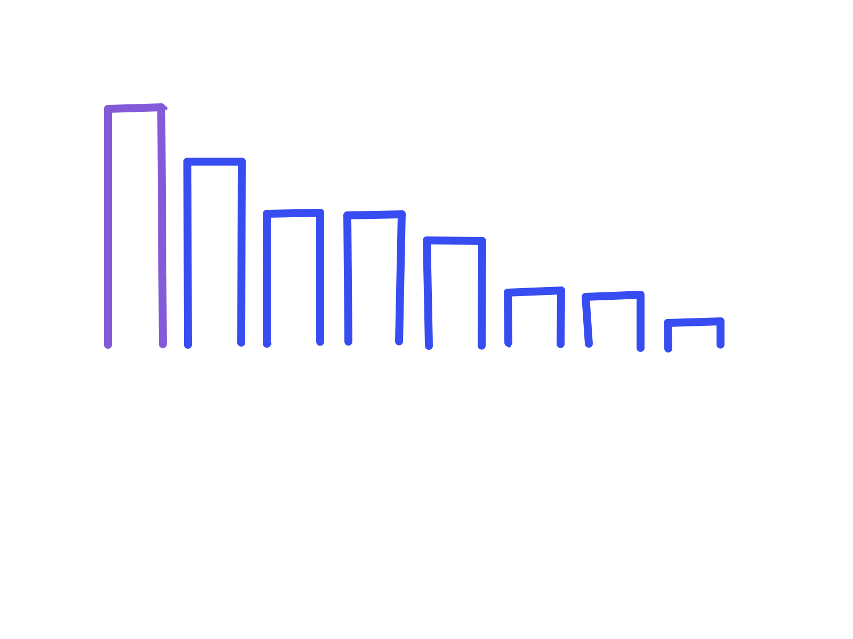
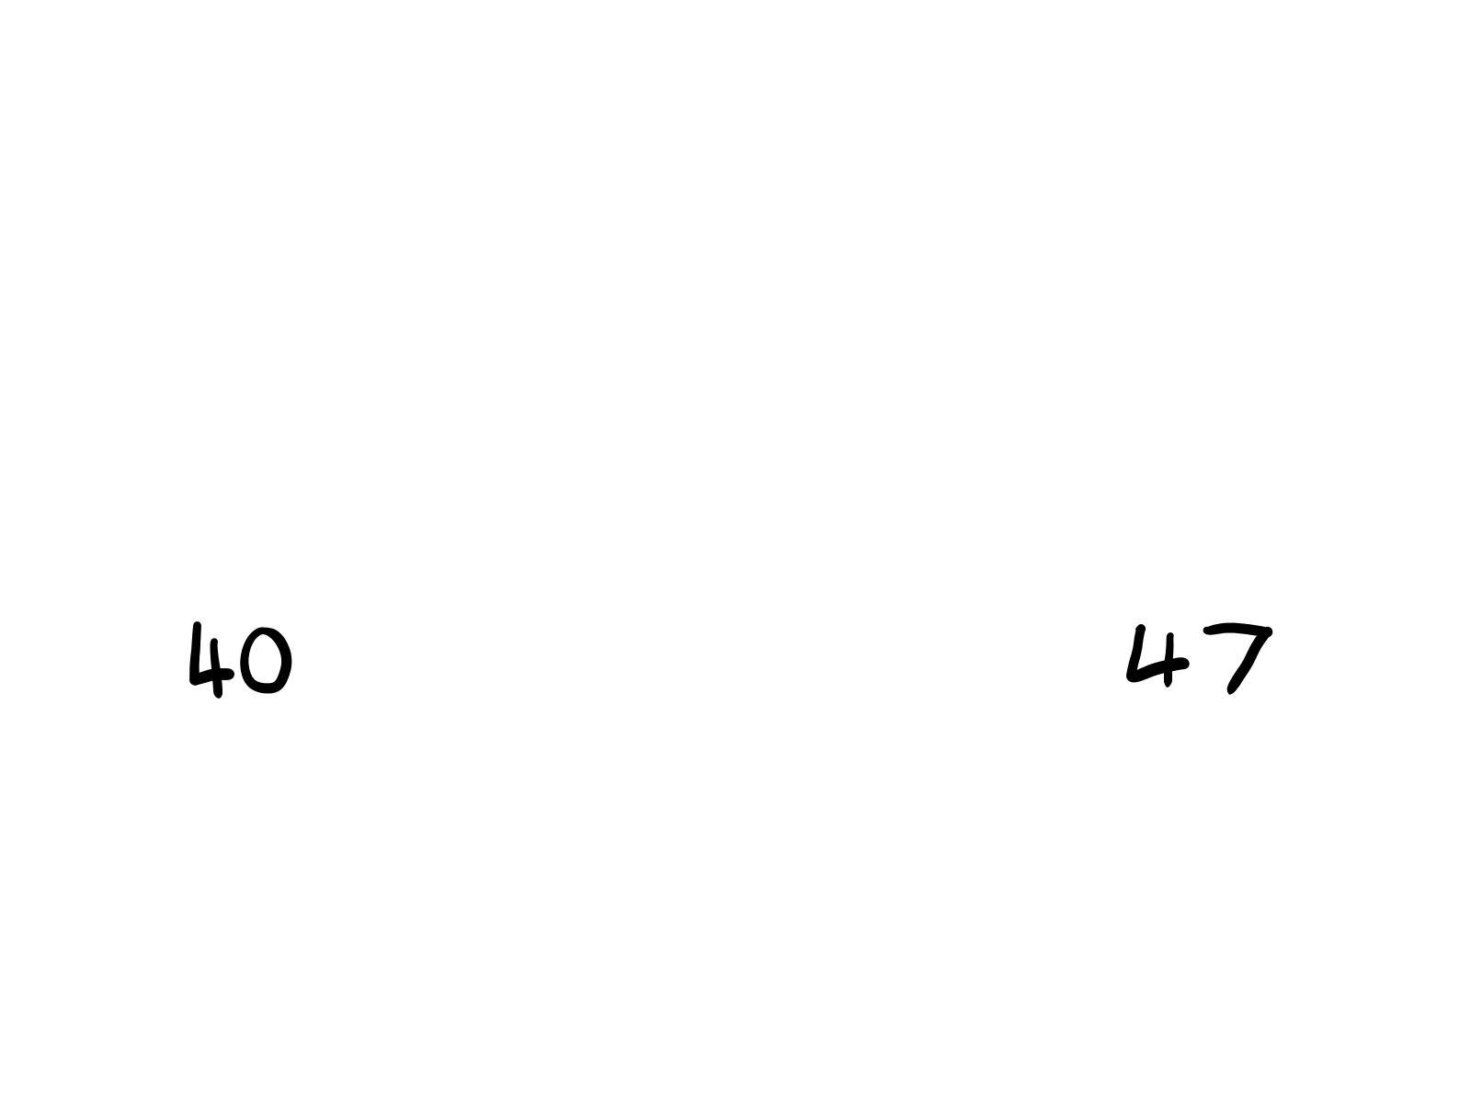
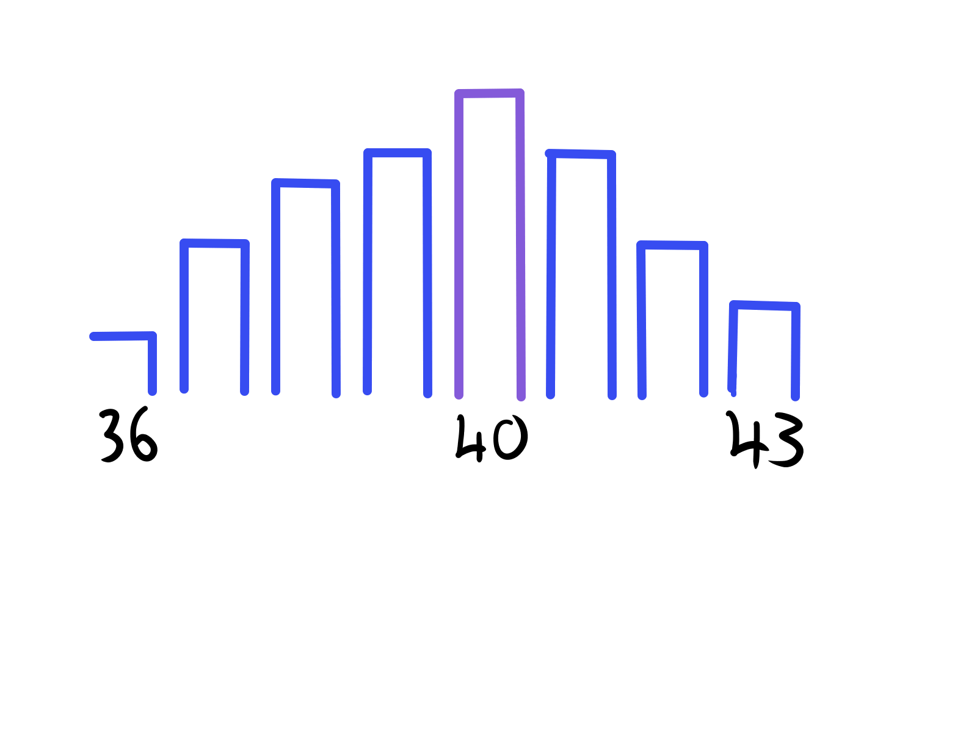
Sketching graphs from summary statistics
Using only the summary statistics below and labelling the minimum and maximum values on the x-axis, sketch two different bar charts.
mode | 40
range | 7
Each bar must still be of approximately the same width, and still have gaps between each bar.
The heights of the bars you draw do not need to be perfectly accurate.

Slide 37
Sketching graphs from summary statistics
What makes these sketches and not fully accurate bar charts?
y-axis not fully numbered
x-axis numbered with only important values (such as mode, maximum and minimum values)
bar heights may not be drawn perfectly to scale

Slide 38
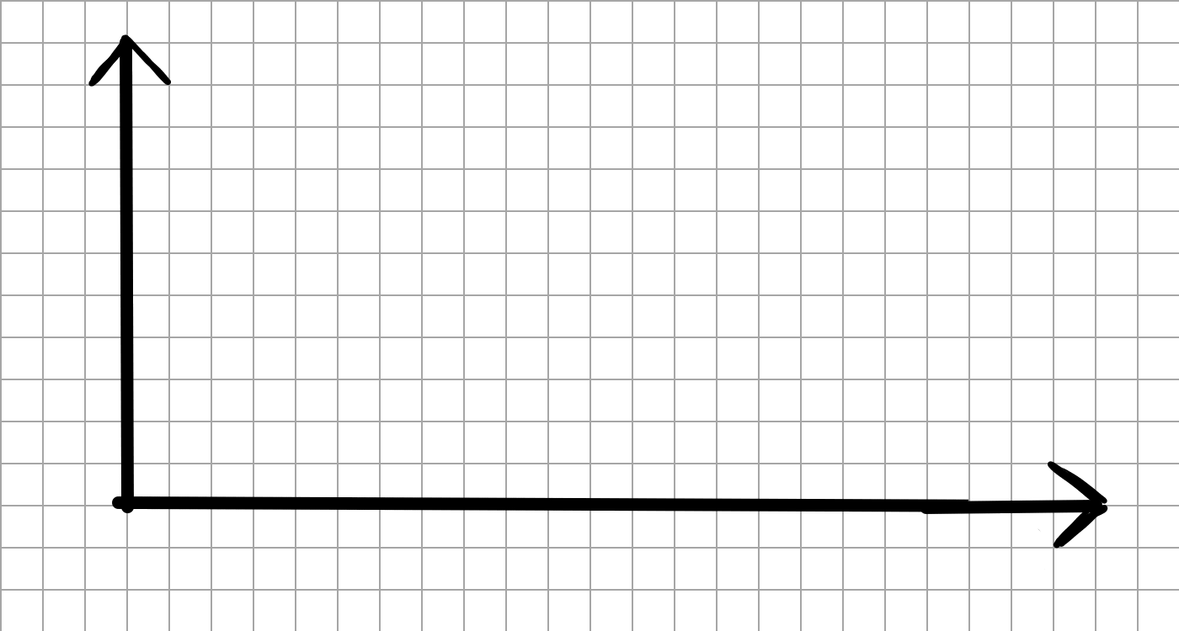
Sketching graphs from summary statistics
Sketch this information on a vertical line graph.
mode | 15
mode | 14
Sketch this information on a vertical line graph.
range | 10
range | 8
the data point 12 has half the frequency of the mode
the data point 11 has half the frequency of the mode
10 × 2 + 2 = 22 squares
Step 1: draw your axes.
The height can be anything suitable, but the length should be a minimum of double the range of the dataset, plus two extra squares.

Slide 39
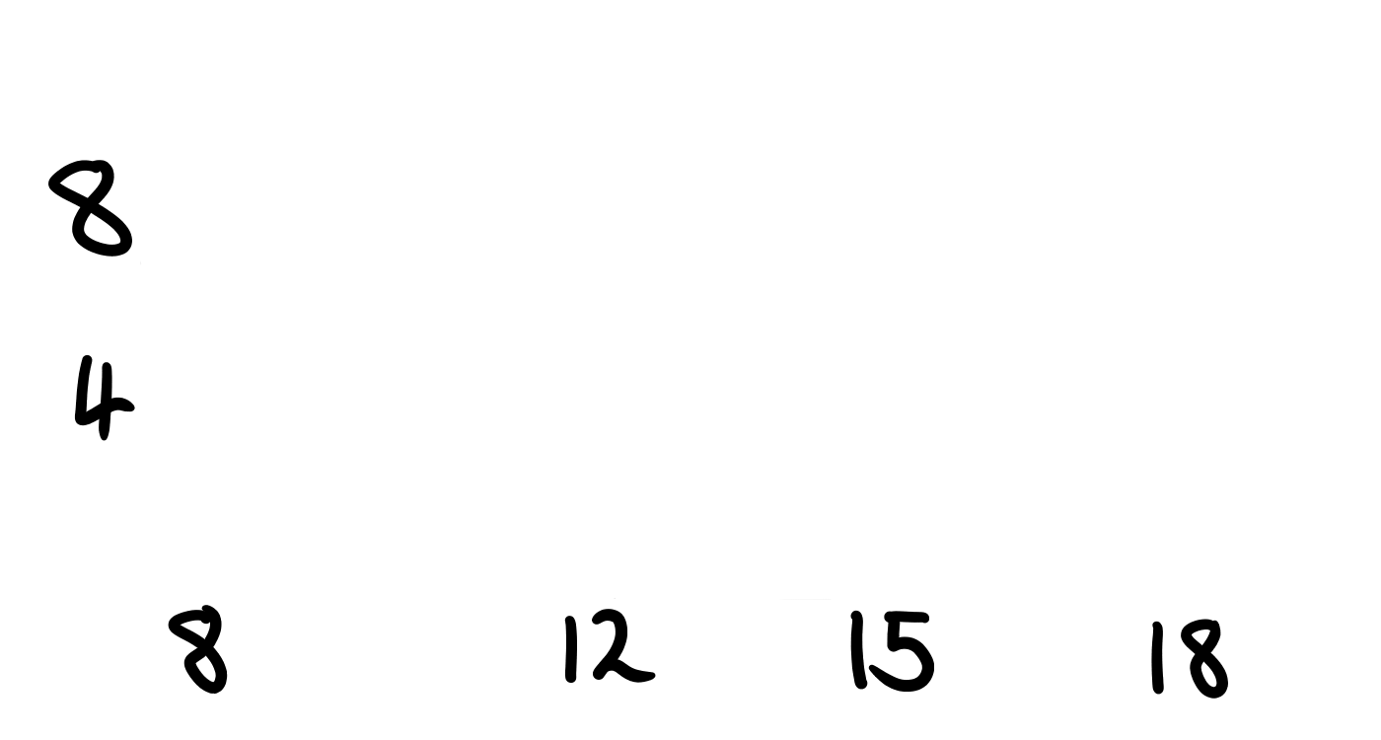
Sketching graphs from summary statistics
Sketch this information on a vertical line graph.
mode | 15
mode | 14
Sketch this information on a vertical line graph.
range | 10
range | 8
the data point 12 has half the frequency of the mode
the data point 11 has half the frequency of the mode
Each 2 squares will be 1 vertical line.
Since the range is 10, jump 2 squares 10 times and label 18.
Along the way, also mark accurately any other important values, such as the mode of 15 and the other point of 12.
I chose a minimum of 8
Step 2: plan the location of key values on the x-axis.
Consider where the modal value will be located, as well as you minimum and maximum values.

Slide 40
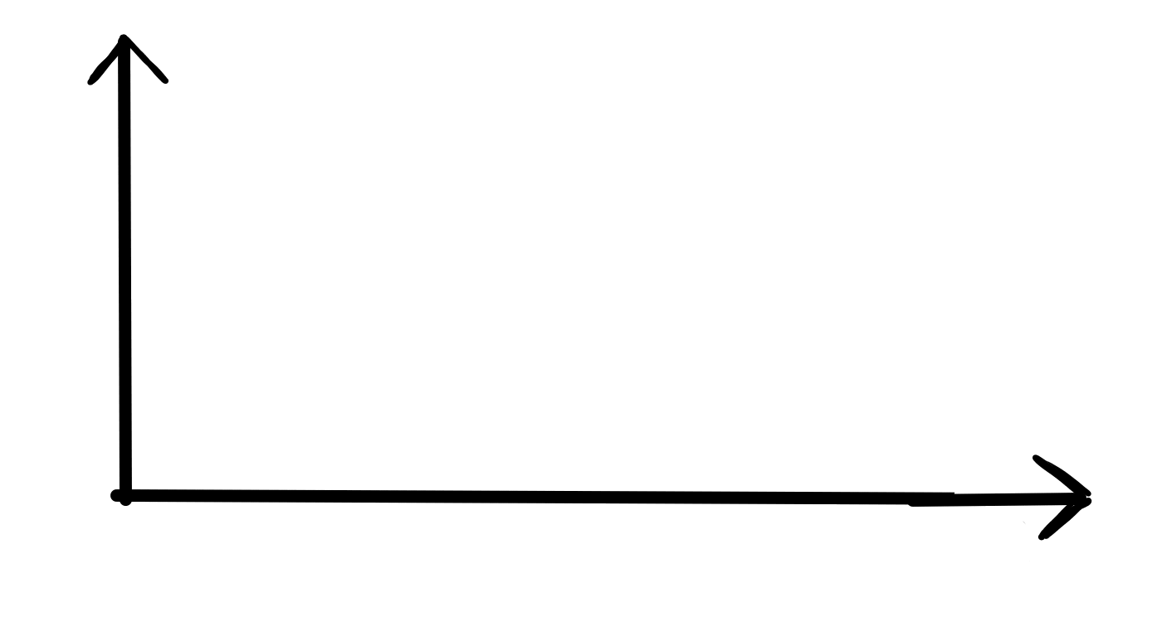
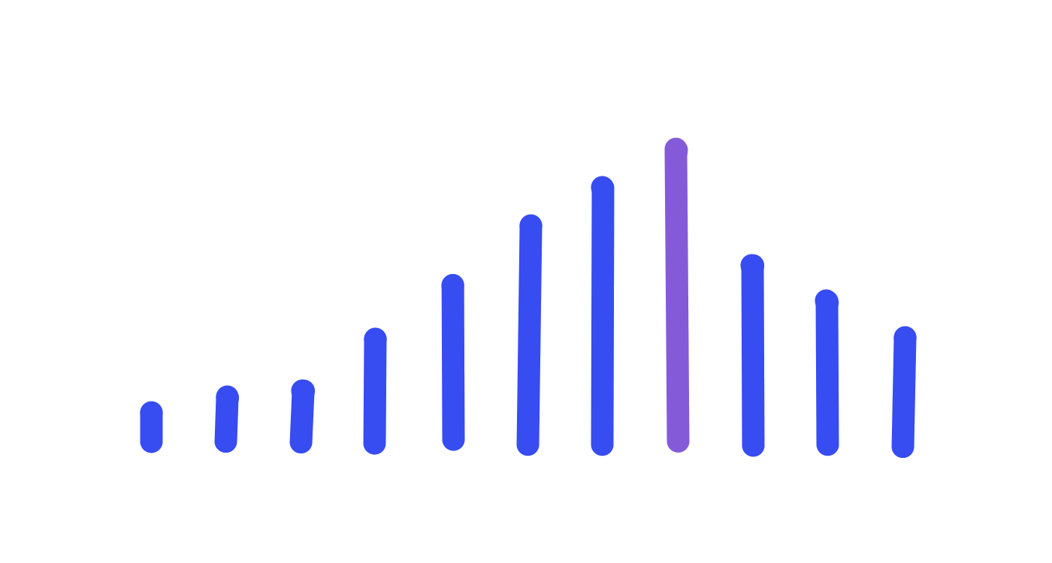
Sketching graphs from summary statistics
Sketch this information on a vertical line graph.
Sketch this information on a vertical line graph.
mode | 14
range | 10
range | 8
the data point 12 has half the frequency of the mode
the data point 11 has half the frequency of the mode
Step 3: draw the vertical lines / dots / bars for the important values
Draw on the modal value up to near the top of the y-axis to make sure no other value goes higher.

Slide 41
Sketching graphs from summary statistics
Sketch this information on a vertical line graph.
mode | 15
mode | 14
Sketch this information on a vertical line graph.
range | 10
range | 8
the data point 12 has half the frequency of the mode
the data point 11 has half the frequency of the mode
In a sketch, you do not need to draw perfect half heights.
As long as it is close to accurate, the graph should still be representative of the dataset.

Slide 42
Sketching graphs from summary statistics
Sketch this information on a vertical line graph.
mode | 15
mode | 14
Sketch this information on a vertical line graph.
range | 10
range | 8
the data point 12 has half the frequency of the mode
the data point 11 has half the frequency of the mode
Step 4: complete the rest of the vertical lines / dots / bars, making sure maximum, minimum, and modal values are not broken.

Slide 43
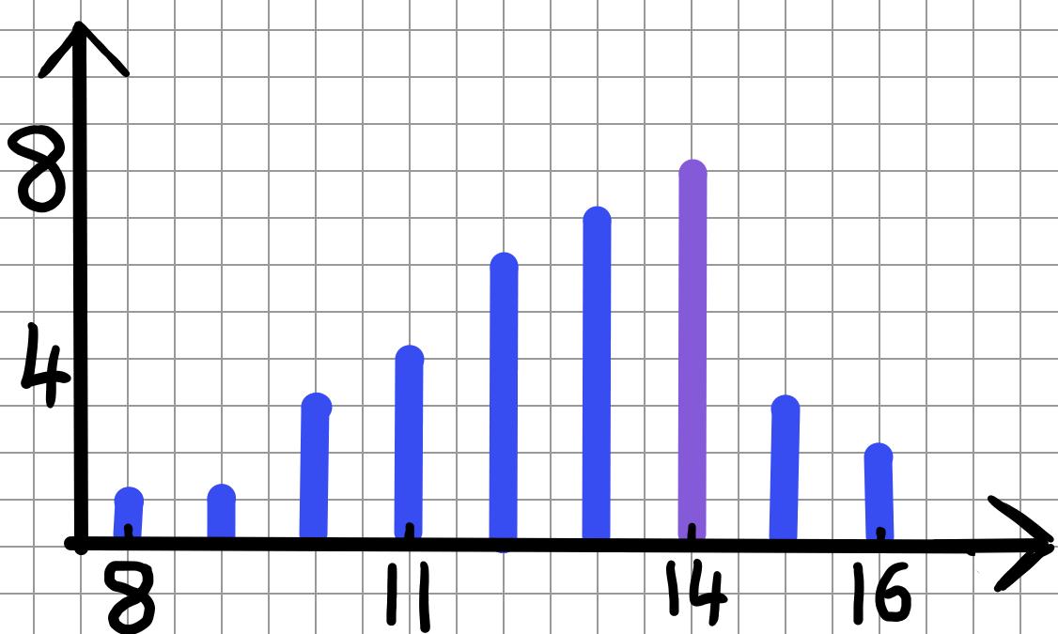
Sketching graphs from summary statistics
Sketch this information on a vertical line graph.
mode | 15
mode | 14
Here’s an example of what yours may look like.
range | 10
range | 8
the data point 12 has half the frequency of the mode
the data point 11 has half the frequency of the mode

Slide 44

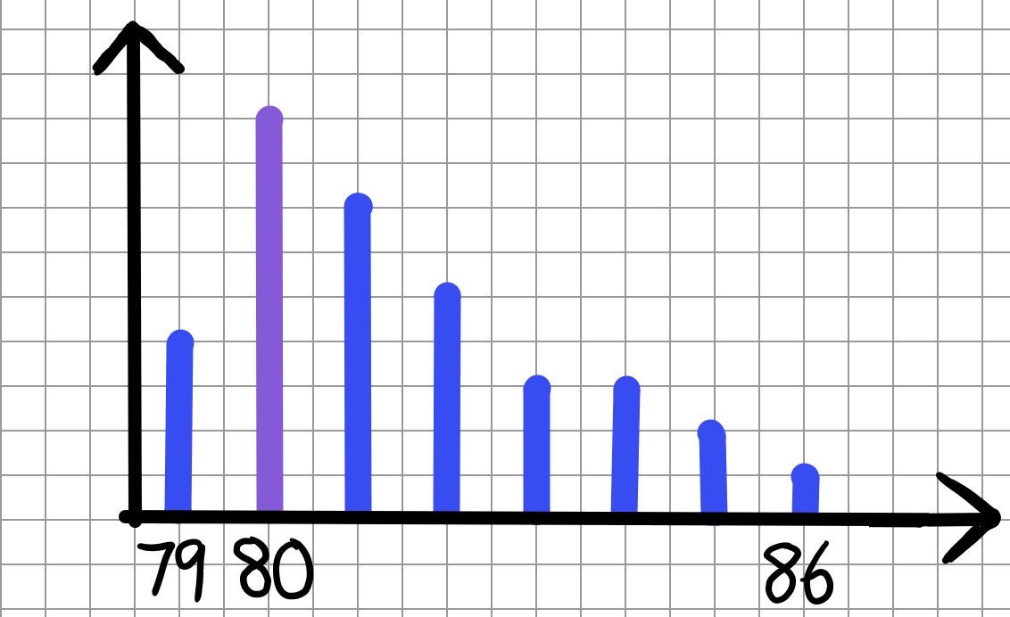
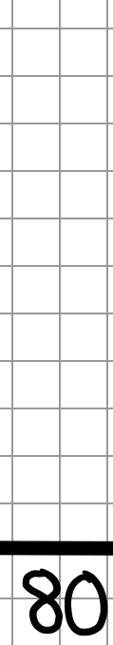
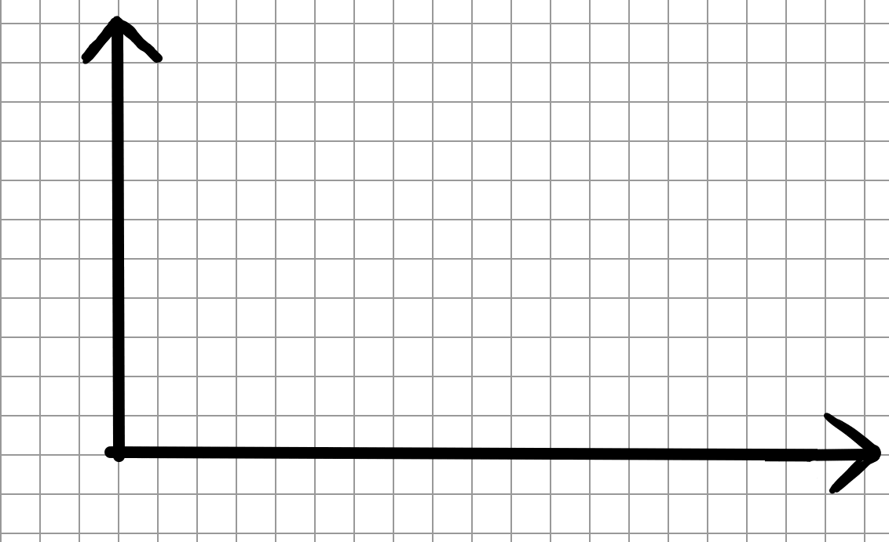
Sketching graphs from summary statistics
1) Jacob wants to sketch a vertical line chart of these summary statistics.
mode | 80
range | 7
a) Write down a calculation to show why the x-axis must be at least 16 squares across.
b) Complete the vertical line graph that Jacob started.
c) Draw a different vertical line graph that also represents the summary statistics Jacob used.

Slide 45
Sketching graphs from summary statistics
2) Sketch two different dot plots that represents the information below.
One of these dot plots must show a bimodal dataset.
median | 14

Slide 46
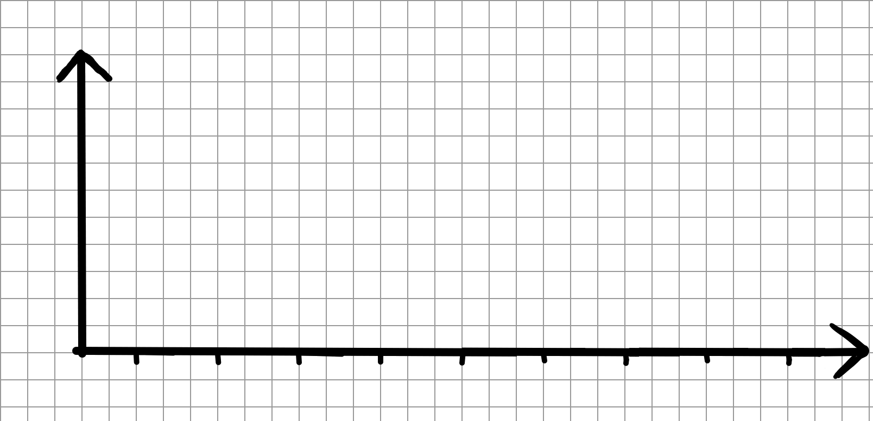
Sketching graphs from summary statistics
3) Sketch a bar chart that represents the information below.
The bar chart may not go across the whole x-axis.
mode | bimodal at 4 and 7
range | 6
minimum value | 2

Slide 47
Sketching graphs from summary statistics
1) Jacob wants to sketch a vertical line chart of these summary statistics.
mode | 80
range | 7
a) Write down a calculation to show why the x-axis must be at least 16 squares across.
7 × 2 + 2 = 16, this is 2 squares per
vertical line drawn
b) Complete the vertical line graph that Jacob started.
c) Draw a different vertical line graph that also represents the summary statistics Jacob used.
75
80
82
This is just one example

Slide 48
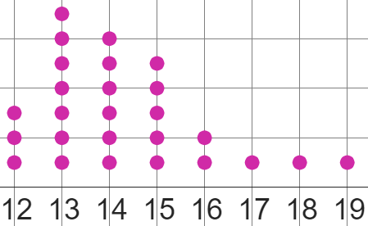
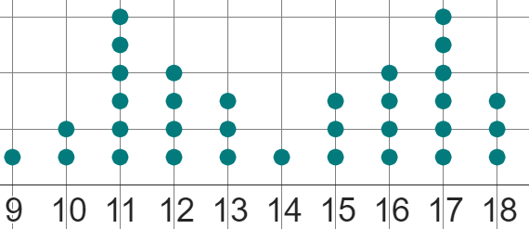
Sketching graphs from summary statistics
2) Sketch two different dot plots that represents the information below.
One of these dot plots must show a bimodal dataset.
median | 14
These are examples of the many ways of representing this information on a dot plot.
With the single mode dot plot, 14 should be close to the peak, whilst on the bimodal data, 14 should be in between the two modes.

Slide 49
Sketching graphs from summary statistics
3) Sketch a bar chart that represents the information below.
The bar chart may not go across the whole x-axis.
mode | bimodal at 4 and 7
range | 5
minimum value | 2
2
4
7
There are many possible ways of sketching this bar chart.
As long as 2 is the minimum value, 7 is the maximum value, and 4 and 7 are the tallest bars, the rest can be represented differently.

Slide 50
Analysing different statistical representations
It is possible to compare statistical summaries to properties of graphs, and use these statistical summaries to complete bar charts with missing data.
It is important to know that the significance of some statistical summaries as a means of representing a dataset decrease if the data are bimodal.
Sketching bar charts, dot plots, and vertical line graphs are quick ways of visualising possible graphs that fit a particular distribution defined by summary statistics.

Slide 51

© Oak National Academy 2023.
Produced in partnership with Mathematics in Education and Industry.
Licensed on the Open Government Licence v3.0, except where otherwise stated. See Oak terms and conditions.

